Slide 1
WHAT IS ACID RAIN?
Acid rain is rain that is more acidic than normal.
Acid rain's spread and damage involves weather, chemistry, soil, and the life cycles of plants and animals on the land and from acid rain in the water.
Sulfur dioxide and nitrogen oxides, the major sources of acid rain.

Slide 2
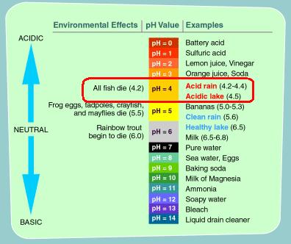
Measurement of acidity of Rain

Slide 3
TYPES OF ACID RAIN
ACID RAIN
Wet Deposition
Dry Deposition

Slide 4
Acid Rain
Wet Deposition:-
Wet deposition refers to acidic rain, fog, and snow. As this acidic water flows over and through the ground, it affects a variety of plants and animals.
Dry Deposition:-
Dry deposition refers to acidic gases and particles. Dry deposition is the free fall to Earth directly from the atmosphere of atmospheric trace gases and particulate matter. About half of the acidity in the atmosphere falls back to earth through dry deposition.

Slide 5
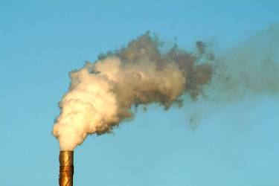

CAUSES OF ACID RAIN
Burning coal, Oil and natural gas, in power stations makes electricity, giving off sulphur dioxide gas.
Burning petrol and oil in vehicle engines gives off nitrogen oxides as gases.
These gases mix with water vapour and rainwater in the atmosphere producing weak solutions of sulphuric and nitric acids – which fall as acid rain.

Slide 6
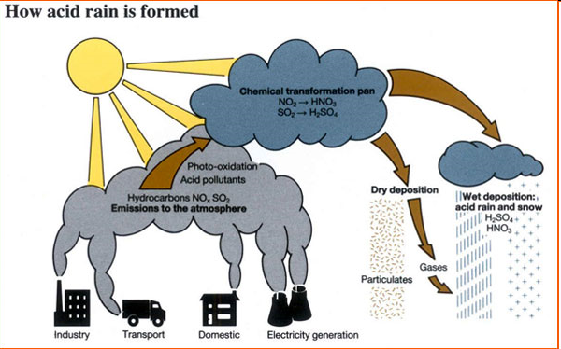

Slide 7
Effects Of Acid Rain
Effects Of Acid Rain
a). On Non-Living
b). On Living
c). On Soil

Slide 8
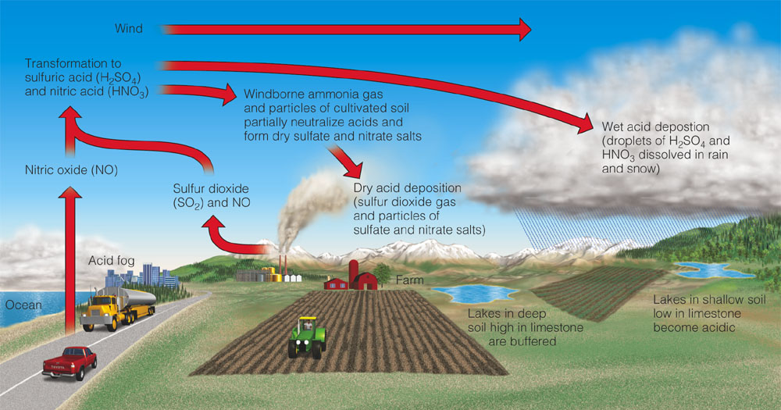
Air Pollution from Acid Deposition
Wet deposition
Dry deposition

Slide 9


Effect on non-living
The Taj Mahal in Agra, suffering from sulphur di oxide, sulphuric acid and other fumes pollutants released from Mathura Refinery.
Acid Rain causes extensive damage to building, statues, bridges, & structural materials of marble, lime stone, etc.

Slide 10
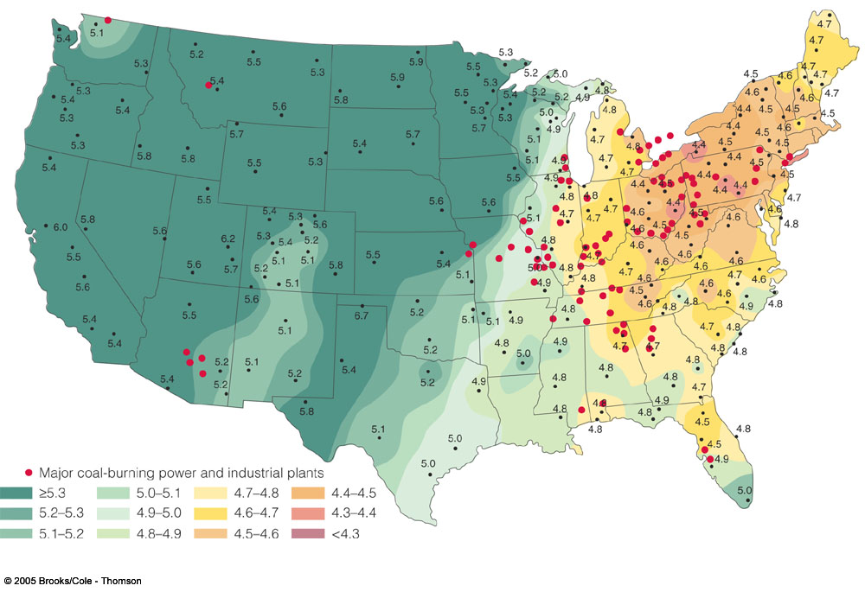
Acid Deposition in the US

Slide 11
Acid Deposition and Humans
Respiratory diseases
Toxic metal leaching
Damage to structures, especially containing calcium carbonate
Decreased visibility
Decreased productivity and profitability of fisheries, forests, and farms

Slide 12
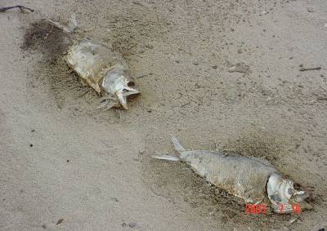
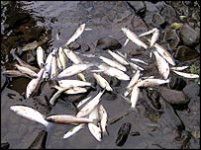
On Water Animals
Acid Rain increases the acidity of lakes & rivers, which is directly affecting the aquatic ecosystem.

Slide 13
On Trees & Soil
Acid Rain dissolves all the nutrients and the useful minerals for the tree to grow.
Weakens the process of photosynthesis.
Acid Rain leaches potassium, calcium, magnesium, etc essential elements from the top of soil & When soil is contaminated, cereal (arable) production crops.
Acids activate aluminium from the soil which leaches into water and fish die. Drinking water is contaminated.

Slide 14
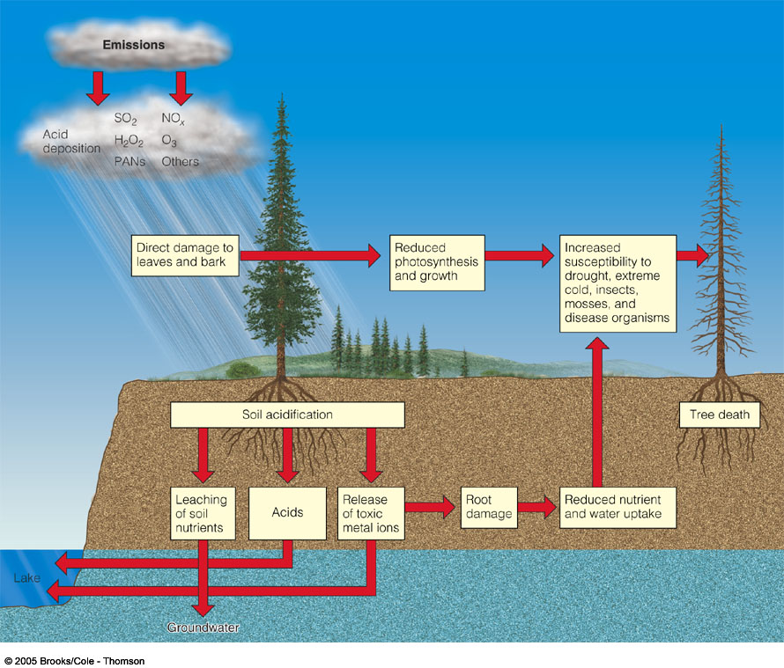
Acid Deposition, Plants, and Soil
Nutrient leaching
Heavy metal release
Weakens trees

Slide 15
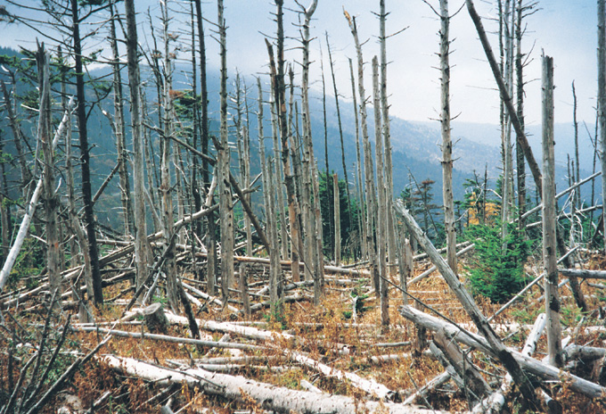
Mountains of North Carolina
Acid Rainfall affects:
Plants - directly (weakens or kills plants)
Plants - indirectly (lower soil nutrients,
insects attack weak trees)
Soils - directly (leaching of base cations eg, Ca & Mg)
15
Notes:
Typically, negative impacts on ecosystems are complicated and not necessarily due to one single factor. Negative impacts in the Appalachian Mountains of North Carolina, such as these at Mount Mitchell, are likely to be due to multiple impacts, that may be very difficult to understand completely. In the case of this Frazier fir stand, the Balsam Wooly adelgid, and insect similar to an aphid, actually killed the trees. However, it is likely that stresses such as those from atmospheric deposition in the region made the trees more susceptible to attack by the aphid. Many scientists have all argued about the reasons responsible for buybacks such as these on Mount Mitchell, but there is no resolution to the exact causes.

Slide 16
Harmful Effects of Acid Deposition
Structural damage
Respiratory diseases in humans
Toxic metal leaching
Kills fish and other aquatic organisms
Leaches plant nutrients from soil
Acid clouds and fog at mountaintops

Slide 17
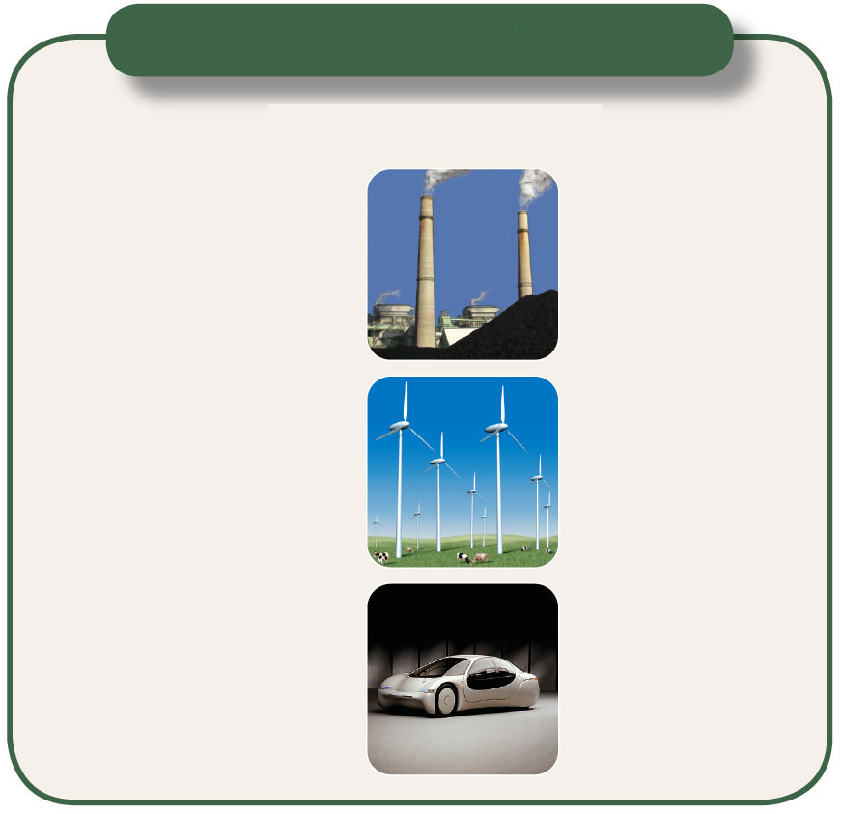
Solutions
Acid Deposition
Prevention
Cleanup
Reduce coal use
Add lime to neutralize
acidified lakes
Burn low-sulfur coal
Increase natural gas use
Add phosphate
fertilizer to neutralize
acidified lakes
Increase use of renewable
energy resources
Remove SO₂ particulates
and NO_{x} from smokestack gases
Remove NO_{x} from motor
vehicular exhaust
Tax emissions of SO₂
Reduce air pollution by
improving energy efficiency
Fig. 15-7, p. 376
Notes:
Figure 15.7: Methods for reducing acid deposition and its damage. Questions: Which
two of these solutions do you think are the most important? Why?

Slide 18
How Should We Deal with Air Pollution?
Legal, economic, and technological tools can help clean up air pollution, but the best solution is to prevent it.

Slide 19
U.S. Outdoor Air Pollution Control Laws
Clean Air Acts
Air-quality standards for 6 major pollutants
Levels of these 6 pollutants have fallen dramatically between 1980 and 2008

Slide 20
Air Pollution Control
Clean Air Act (1963) - First national air pollution control. (using incentives, eg federal grants to states)
Clean Air Act (1970) rewrote original Act.
Identified critical pollutants
Established ambient air quality standards.
Primary Standards - Human health
Secondary Standards - Materials, environment

Slide 21
Improving Air Pollution Laws (1)
Emphasize pollution prevention
Increase fuel economy standards
Regulate emissions from two-cycle engines
Regulate ultra-fine particles

Slide 22
Improving Air Pollution Laws (2)
Increase regulations at airports
Decrease urban ozone
Increase regulations for indoor air pollution
Better enforcement of Clean Air Act

Slide 23
Using the Marketplace to Reduce Air Pollution
Emissions trading (cap and trade) program
Proponents – cheaper and more efficient
Critics – companies buy their way out
Success depends on cap being gradually lowered

Slide 24
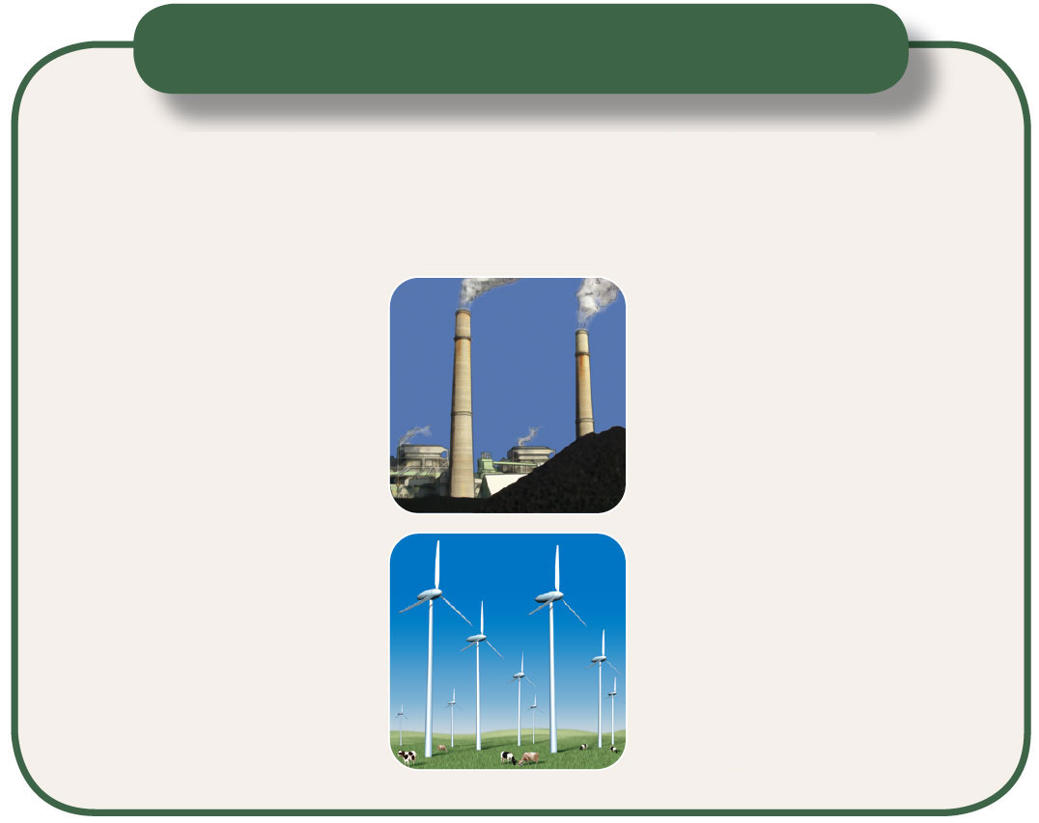
Solutions
Stationary Source Air Pollution
Prevention
Dispersion or
Cleanup
Burn low-sulfur coal
Disperse emissions above
thermal inversion layer with
tall smokestacks
Remove sulfur from coal
Remove pollutants after
combustion
Convert coal to a liquid
or gaseous fuel
Shift to less polluting
energy sources
Tax each unit of pollution
produced
Fig. 15-11, p. 380
Notes:
Figure 15.11: Methods for reducing emissions of sulfur oxides, nitrogen oxides, and particulate matter
from stationary sources such as coal-burning electric power plants and industrial plants (Concept 15-3).
Questions: Which two of these solutions do you think are the most important? Why?

Slide 25

Solutions
Motor Vehicle Air Pollution
Prevention
Cleanup
Use mass transit
Require emission
control devices
Walk or bike
Use less polluting fuels
Inspect car
exhaust systems
twice a year
Improve fuel efficiency
Get older, polluting
cars off the road
Give large tax
write-offs or rebates
for buying low-
polluting, energy
efficient vehicles
Set strict emission
standards
Fig. 15-12, p. 381
Notes:
Figure 15.12: Methods for reducing emissions from motor vehicles (Concept 15-3). To find out what and how much your car emits,
go to www.cleancarsforkids.org. Questions: Which two of these solutions do you think are the most important? Why?

Slide 26
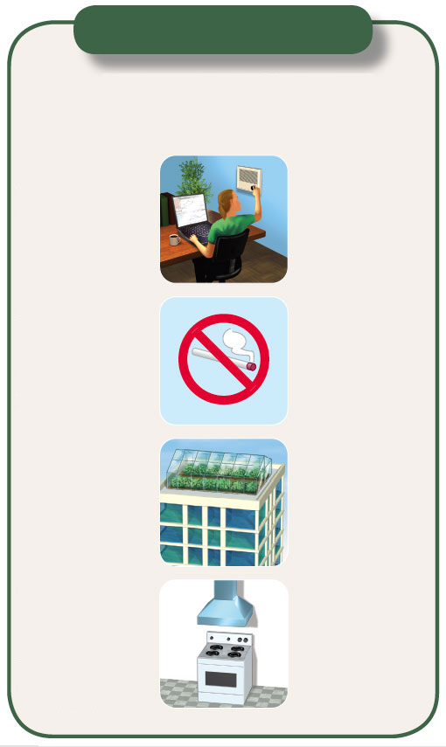
Solutions
Indoor Air Pollution
Prevention
Cleanup or
Dilution
Clean ceiling tiles
and line AC
ducts to
prevent release
of mineral fibers
Use adjustable
fresh air vents for work spaces
Ban smoking or limit it to
well-ventilated
areas
Increase intake of outside air
Set stricter
formaldehyde
emissions standards
for carpet,
furniture, and
building materials
Change air more
frequently
Circulate a
building’s air
through rooftop
greenhouses
Prevent radon
infiltration
Use efficient
venting systems for wood-
burning
stoves
Use office machines
in well-
ventilated areas
Use exhaust hoods
for stoves and
appliances burning
natural gas
Use less
polluting
substitutes for
harmful cleaning
agents, paints,
and other products
Fig. 15-13, p. 381
Notes:
Figure 15.13: Ways to prevent and reduce indoor air pollution (Concept 15-3). Questions: Which two of these solutions do you
think are the most important? Why?

Slide 27
What is the Air Quality Index?
Index for reporting air quality
Color is key for communication
Ranges from 0 to 500 (no units)
Provides indicator of the quality of the air and its health effects
101 typically corresponds to the level that violates the national health standard

Slide 28
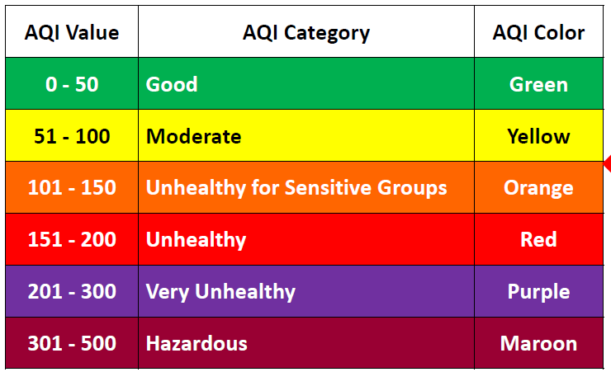
AQI Table

Slide 29
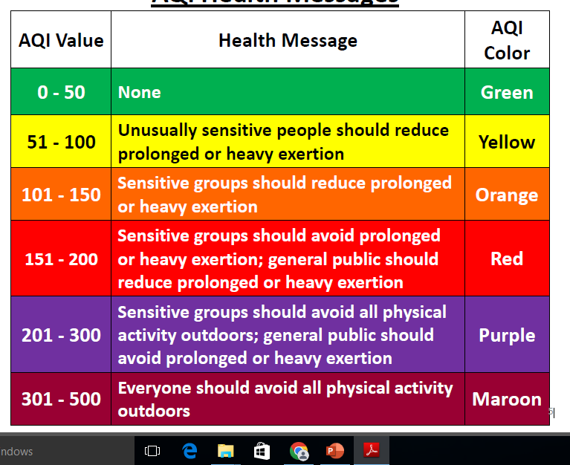
AQI Health messages

Slide 30
Background and History in the U.S.
Prior to 1976:
–55 cities used 14 different indices
–Different cautionary messages
–Confusing to the public
In 1976:
–U.S. Clean Air Act required U.S. Environmental Protection Agency (EPA) to establish a national air quality index
–EPA established the Pollutant Standards Index (PSI)
From 1976 to 1998, EPA and U.S. cities used the PSI that covered:
–Ground-level ozone
–Particulate matter
–Carbon monoxide
–Sulfur dioxide
–Nitrogen dioxide

Slide 31
Background and History in the U.S.
In 1999, EPA revised the PSI
Updated the index
Changed the name to Air Quality Index (AQI)
Received extensive input from:
State/local experts (outreach, health, and air quality)
General public (8 focus groups in major U.S. cities)
Workshops
Ozone and particle pollution standards were added:
8-hour O3 standard
24-hour PM2.5 standard

Slide 32
Advantages of the AQI
AQI is more successful than PSI in many ways:
–Name is better – “Quality” Index versus “Pollutant Standard” Index
–Simple categories (Good, Moderate, etc.)
–Colors are key for communication
•Ability to visualize pollution via maps
•Association between colors and health
–Uniformity

Slide 33
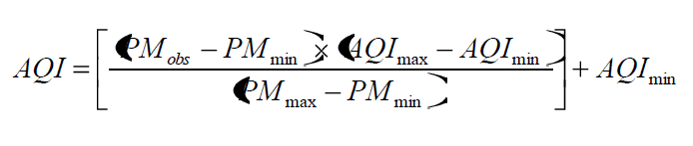
Calculating AQI Values
Calculate the AQI using pollutant concentration data in
the following equation:
PMobs = observed 24-hour average concentration in μg/m3
PMmax = maximum concentration of AQI color category that contains PMobs
PMmin = minimum concentration of AQI color category that contains PMobs
AQImax = maximum AQI value for color category that corresponds to PMobs
AQImin = minimum AQI value for color category that corresponds to PMobs

Slide 34
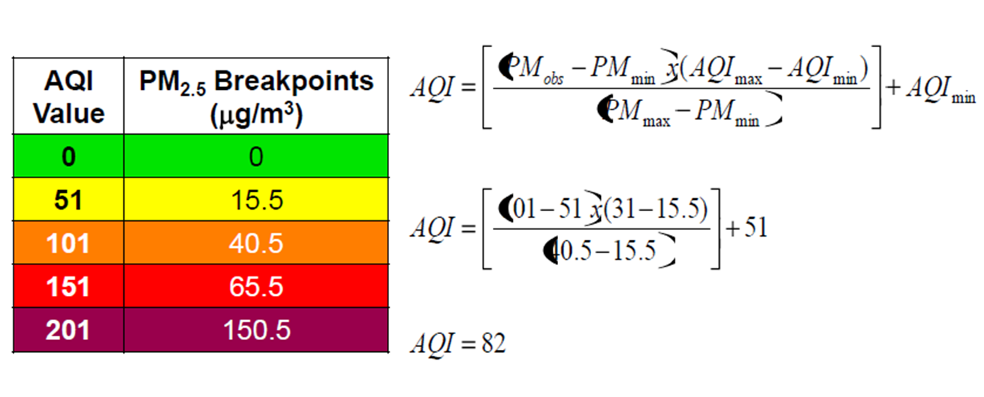
Calculate the AQI corresponding to a 24-hr PM2.5 concentration of 31 ug/m3

Slide 35
Summary AQI
The Air Quality Index (AQI) is a simple, color-coded, unitless index that is an effective way to communicate air pollution concentrations to the general public
The AQI provides an indication of the quality of the air and its health effects
Options exist for scaling the AQI categories to PM2.5 and PM10 concentration values (g/m3)
Simple equation can be used to convert concentration values (g/m3) to AQI values (unitless)

